Slide 1

College Physics 1A
for International Students
Course Instructor:
Yip Cho Tung

Slide 2
Exam Questions Breakup
60% - High-school level for a local student
70% - In class examples excluding calculus
80% - In class examples with calculus
90% - Examples and in-class exercise
97% - plus the homework questions
100% - plus some challenging problems
Notes:
So the bottom line is, after this class you need to be as good as a local high school student who just get into HIT-Shenzhen. The reason is clear – you might need to take the advanced level classes with the local students and the course instructor WILL assume that you have the similar pre-requisite.
You just don’t want to be left behind!

Slide 3
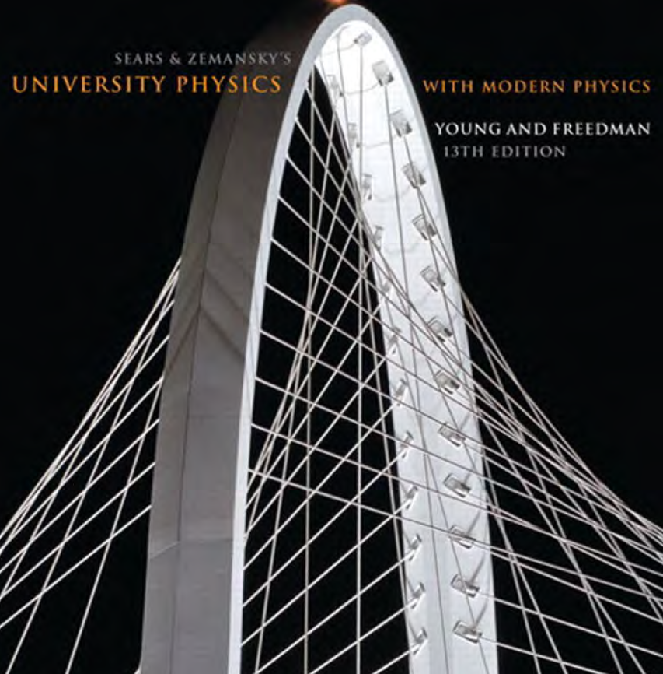
Tips for Survival
Read the textbook before lectures
Come to lectures
Try to solve problems independently
Proactive and interactive
Study groups
Don’t cheat
University Physics with Modern Physics 13th Edition -Addison-Wesley (2012)
Notes:
So here are the tips to do well in this class.
Firstly, of course, be prepared for each class. We follow closely this University Physics book from Addison and Wesley. It is a good one – well written and easy to read.
After you are prepared, of course, please come to lectures and meet your favorite course instructor. In class and after class, I will assign problems as exercises. I would HIGHLY encourage each of you to try solving them by yourself, at least for a minute or so, before seeking for help.
And of course, as a new faculty member, there are things for me to improve, and please help me with your participation in the class. I really appreciate that.
I must apologize ahead, that I have heavy research commitments and might not be able to answer every single question from you. One thing I do realize after coming back to China is that the numbers of TAs available is pretty insufficient.

Slide 4
In Class…
Maintain a quiet environment during lecture (except for questions from/to me)
If you already learned what is being taught:
Work on the problem sets
Use your favorite chatting app on mute
In case you are a generous person who always helps your buddies
Discuss during in-class exercises
Notes:
So, I will ask for a favor from you. Please keep quiet when I am talking unless you want to ask me questions or when I am asking you questions.
I understand that the materials I am covering might be something have learned already. You know I don’t want to waste your time, so I will send out homework problems before each lecture, so you have something to work on. You can also bring homework from other courses.
If you really need to communicate with each other, please, text each other with your favorite chatting apps.
Or, wait during the in class exercise time! For every about 15 minutes, I will assign an exercise problem for you to work on for a few minutes. So, please push off your discussions to that time.
Does that sound like a reasonable plan?

Slide 5
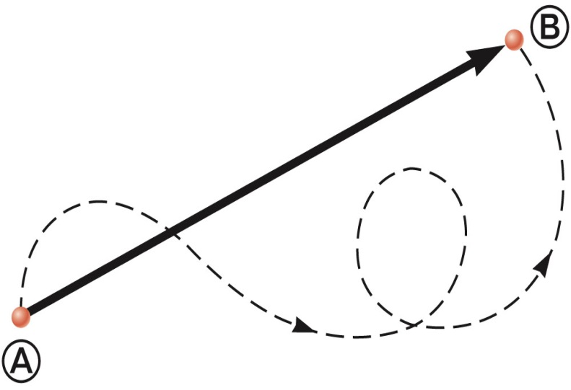
Vectors and Scalars
A scalar quantity is completely specified by a single value with an appropriate unit and has no direction.
A vector quantity is completely described by a number and appropriate units plus a direction.
Example:
A particle travels from A to B along the path shown by the broken line.
This is the distance traveled and is a scalar.
The displacement is the solid line from A to B
independent of the path taken.

Slide 6
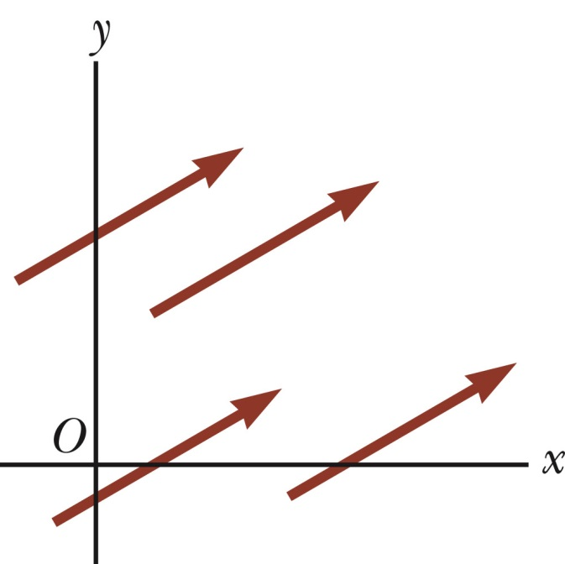
Vector Notation
Text uses bold with arrow to denote a vector:
Also used for printing is simple bold print: A
When dealing with just the magnitude of a vector in print, an italic letter will be used: A or | |
Equality of Two Vectors
Two vectors are equal if they have the same magnitude and the same direction.
All of the vectors shown are equal.
Allows a vector to be moved to a position parallel to itself

Slide 7
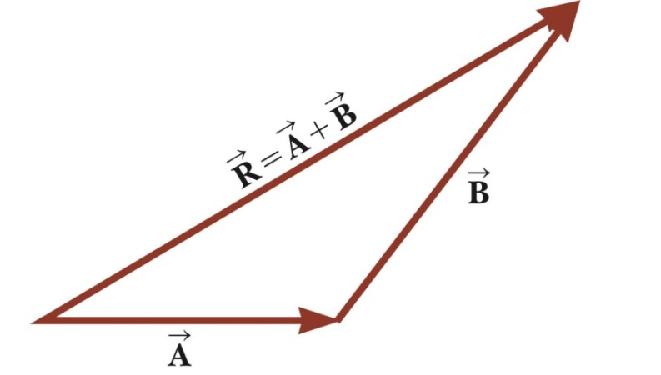
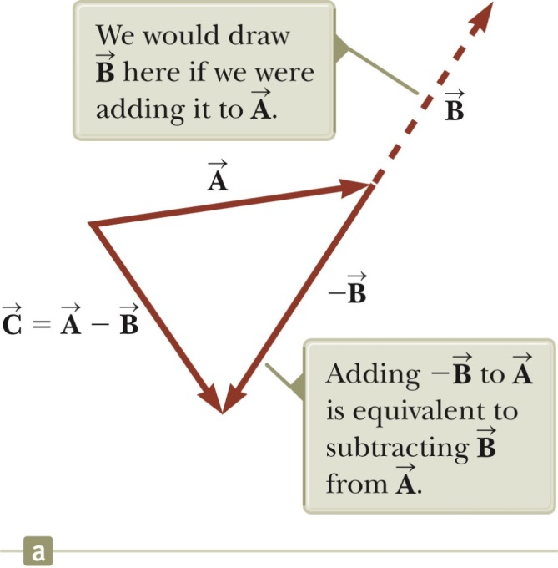
Adding Vectors, Graphically
Choose a scale.
Drawing the vectors “tip-to-tail” or “head-to-tail”.
The resultant is drawn from the origin of the first vector to the end of the last vector.
Negative Vector and Subtracting Vectors
Negative vector: The negative of the vector will have the same magnitude, but point in the opposite direction.
Subtraction is just a special case of vector addition:
If , then use

Slide 8
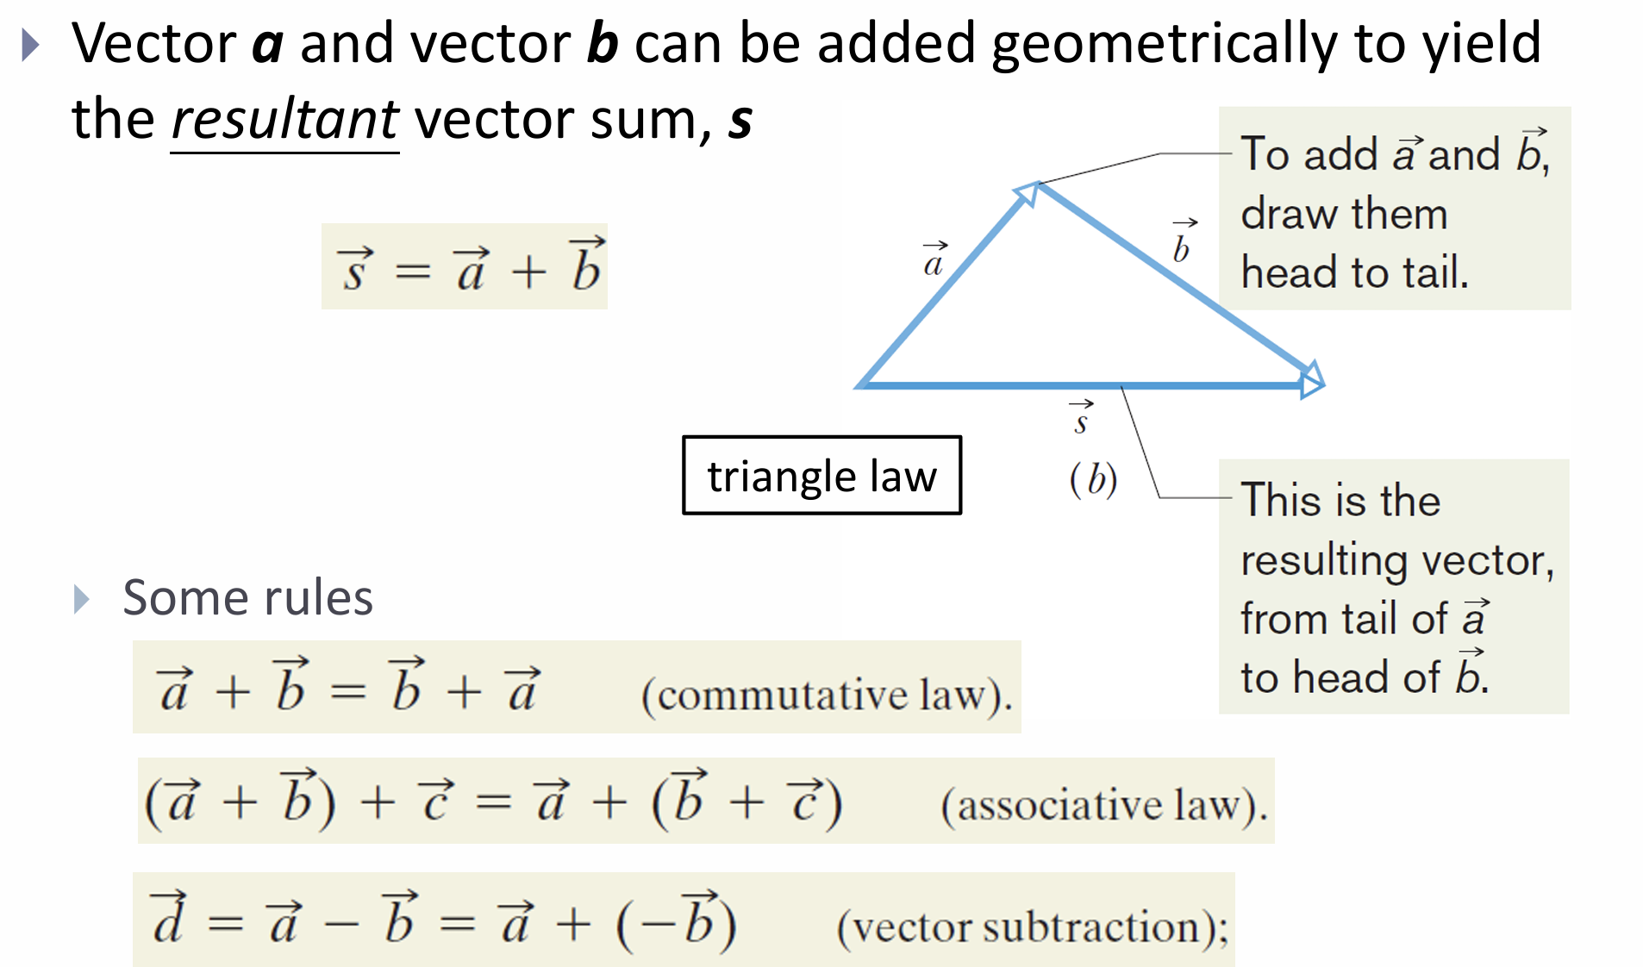

Slide 9
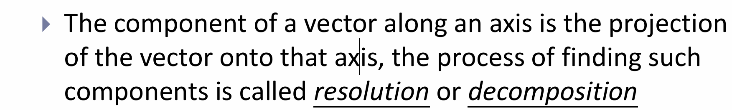
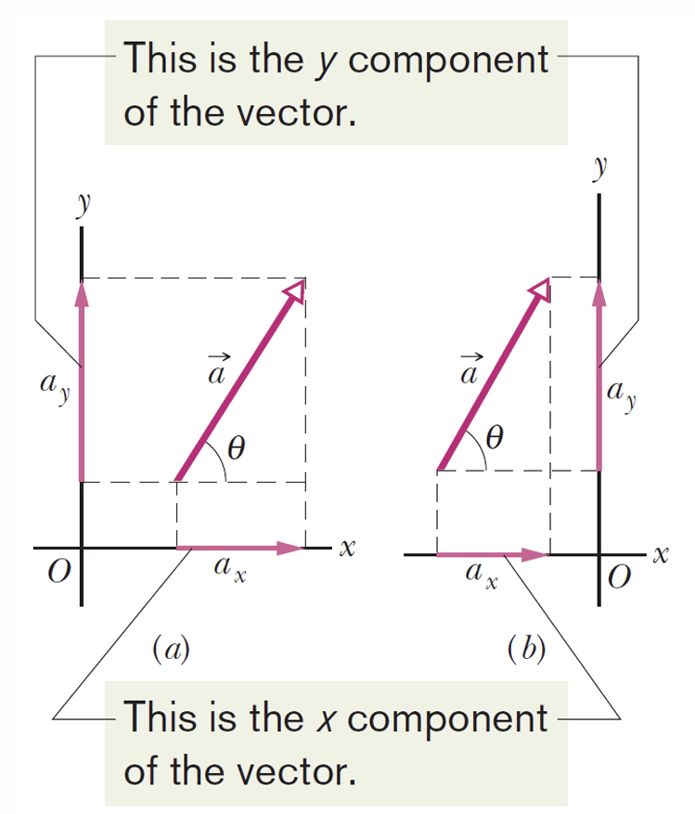
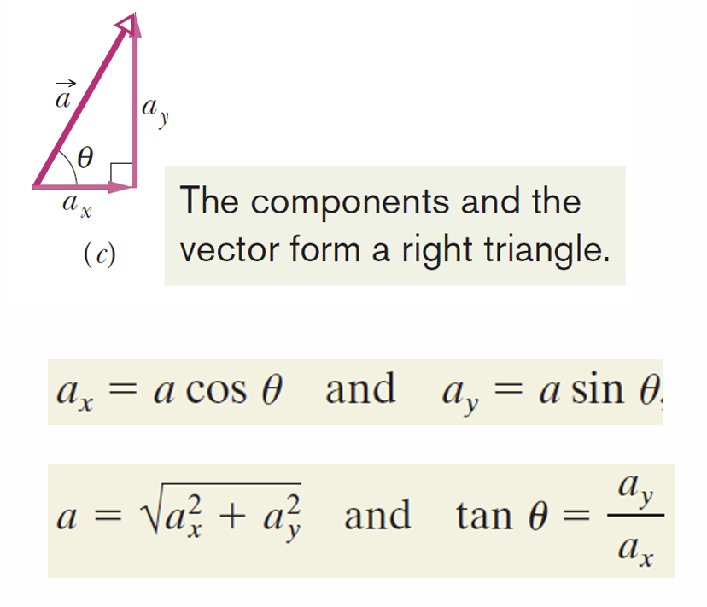

Slide 10
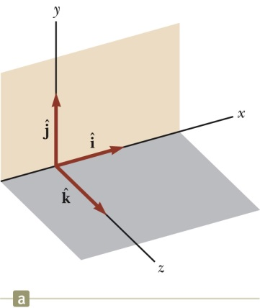
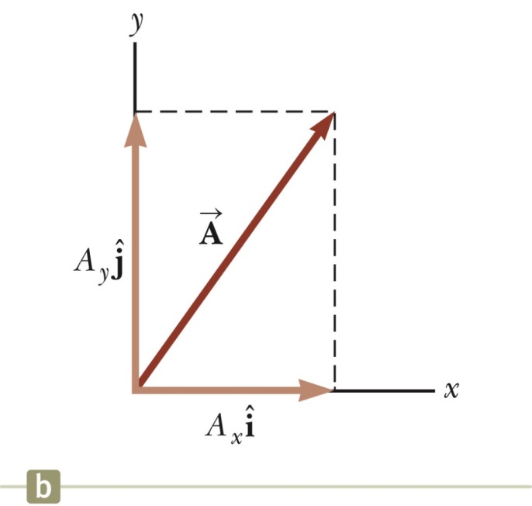
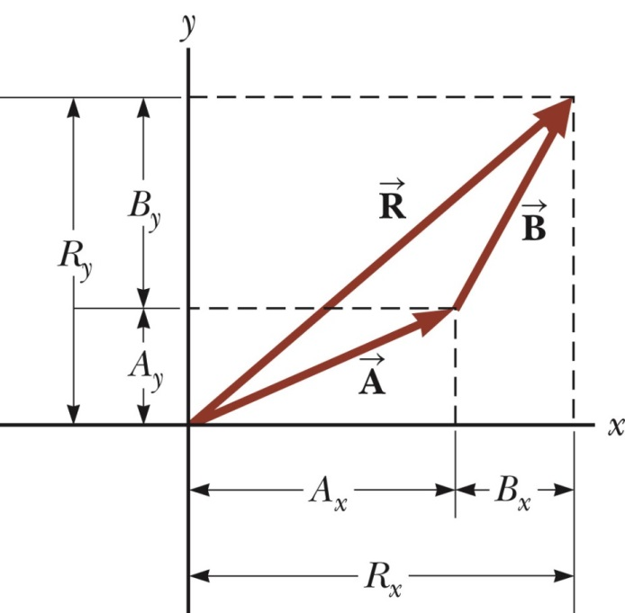
Components of a Vector
A component is a projection of a vector along an axis.
It is useful to use rectangular components, and express the vector in terms of unit vectors, , which represent unit vectors of x-, and y- axes, respectively.
Adding Vectors with Unit Vectors

Slide 11
The x component of vector 𝐴⃑ is –25.0 m and the y component is +40.0 m. (a) What is the magnitude of 𝐴⃑? (b) What is the angle between the direction of 𝐴⃑ and the positive direction of x? [47.2 m; 122°]

Slide 12
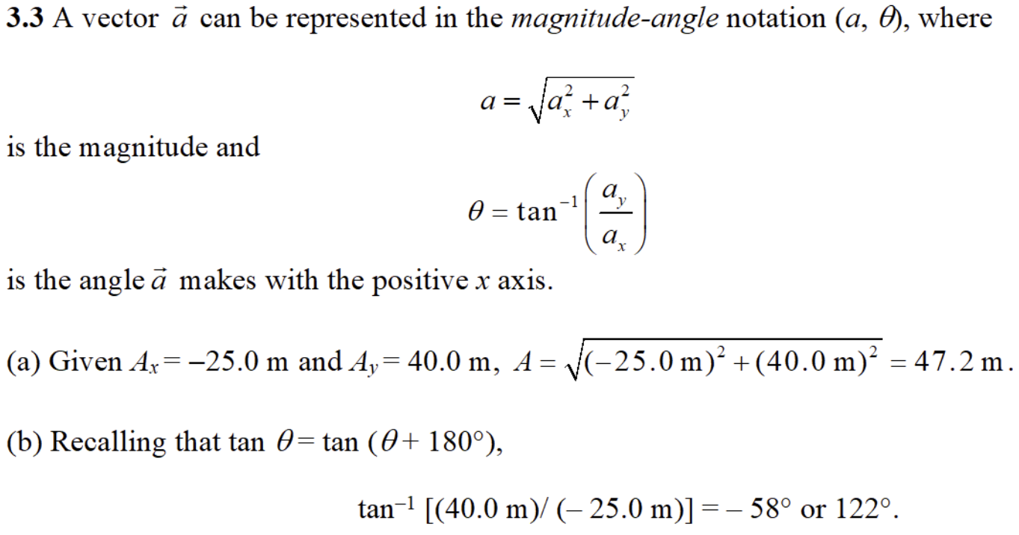

Slide 13
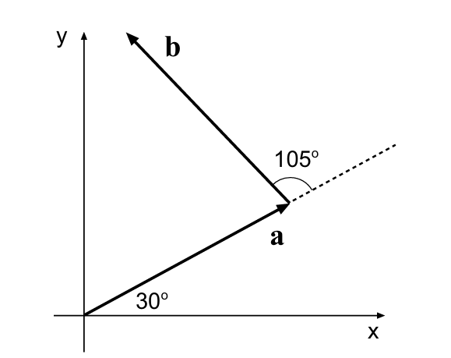
The two vectors a and b in Fig below have equal magnitudes of 10.0m. Find (a) the x component and (b) the y component of their vector sum r, (c) the magnitude of r and (d) the angle r makes with the positive direction of the x axis.

Slide 14
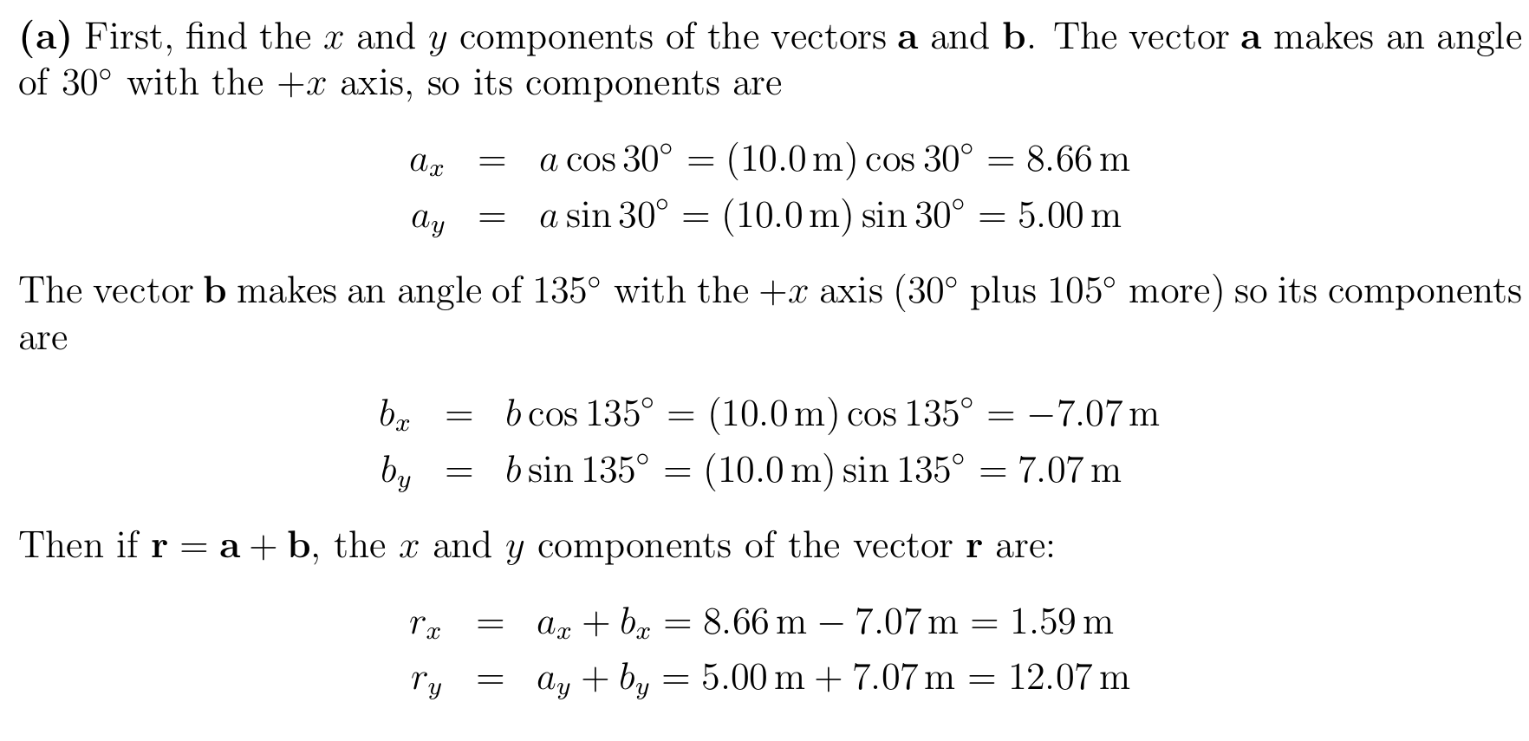

Slide 15
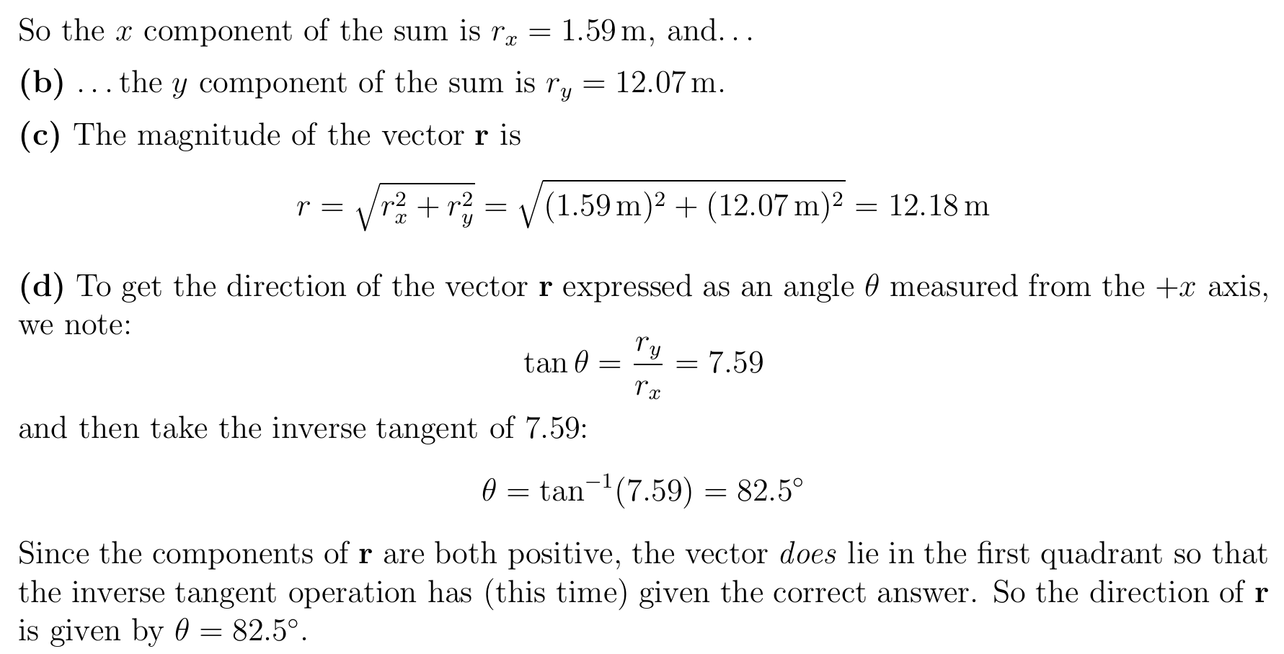

Slide 16
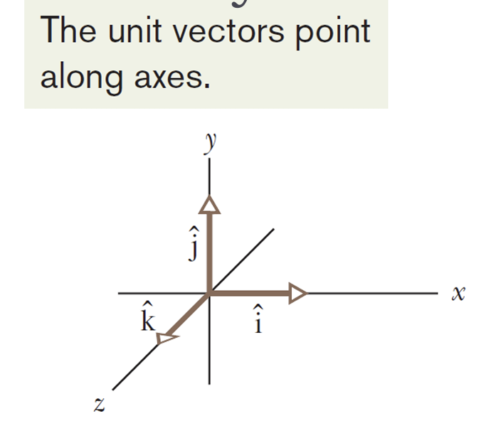
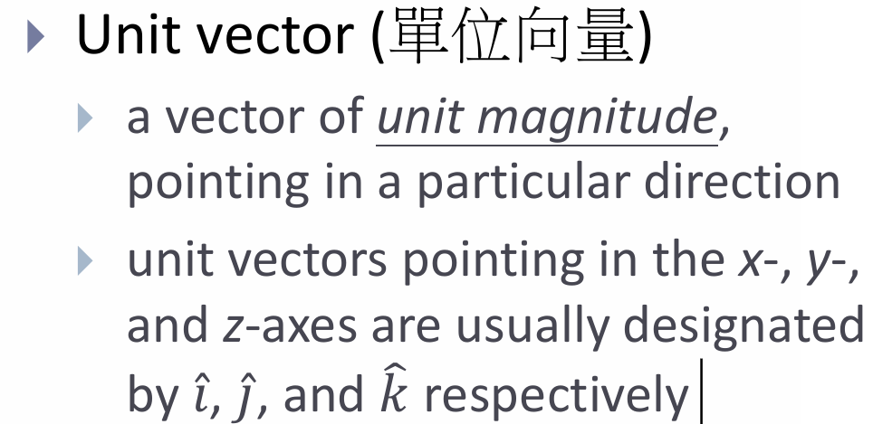
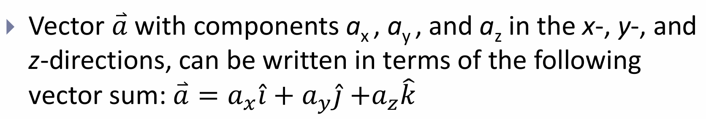
Unit Vectors, Adding Vectors by Components

Slide 17
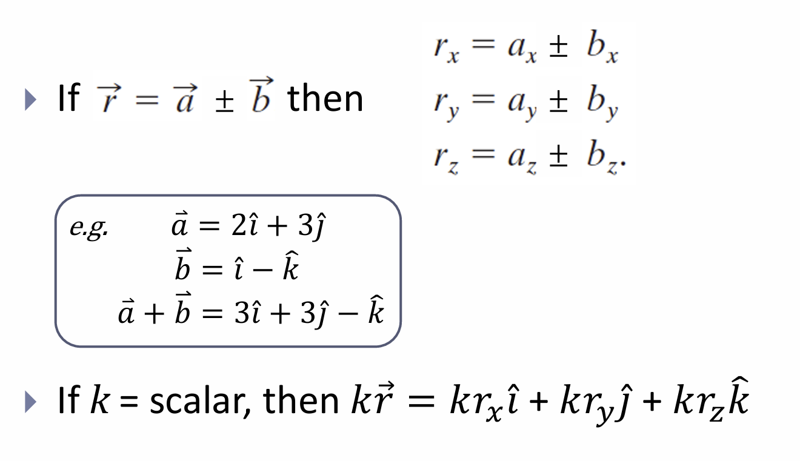
Unit Vectors, Adding Vectors by Components

Slide 18
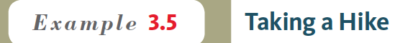
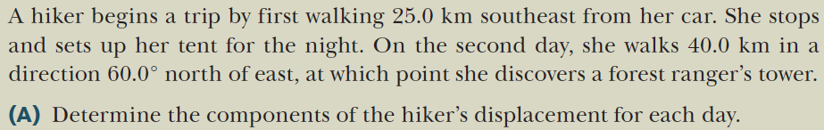
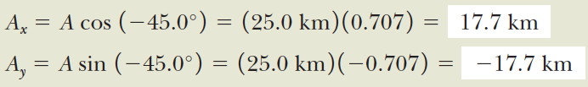
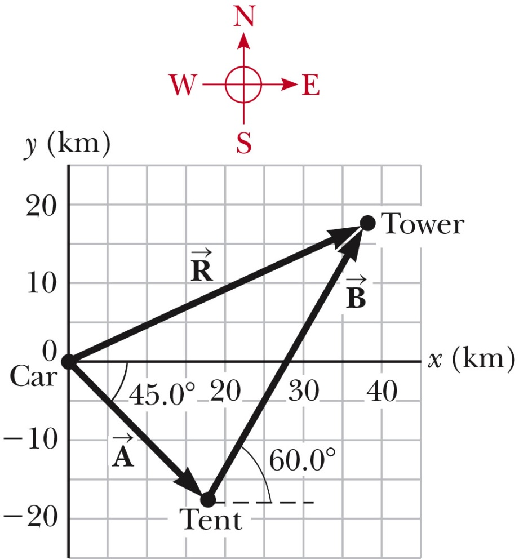
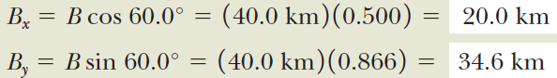
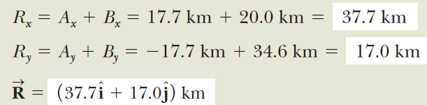

Slide 19
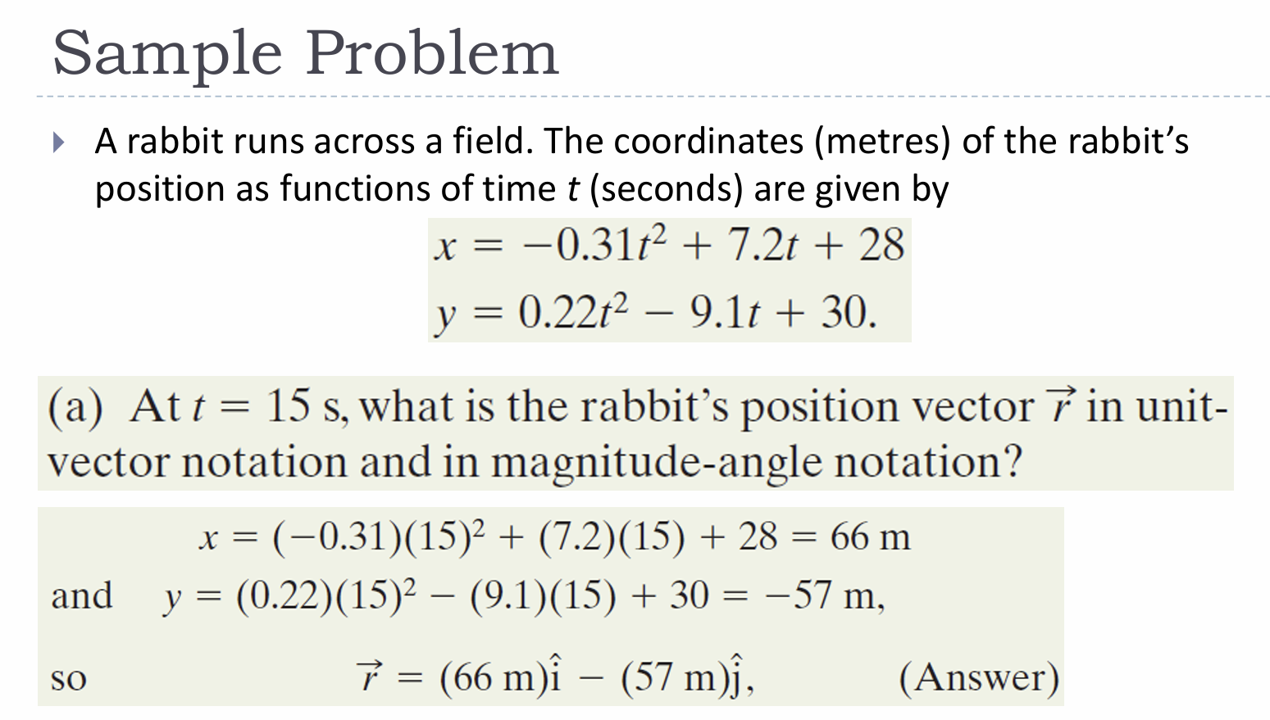
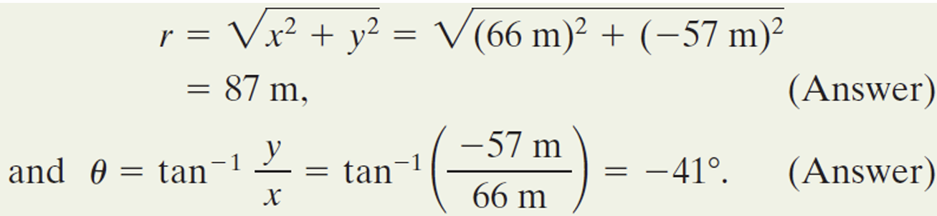

Slide 20
A boat is crossing a river is traveling east at 7m/s. The current of the river is traveling north at 3m/s. At what angle is the boat traveling?

Slide 21
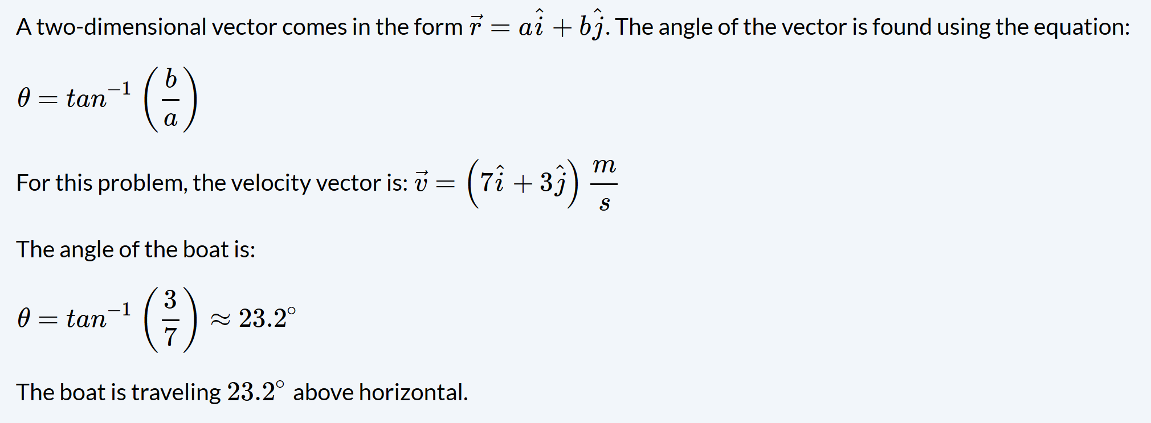

Slide 22

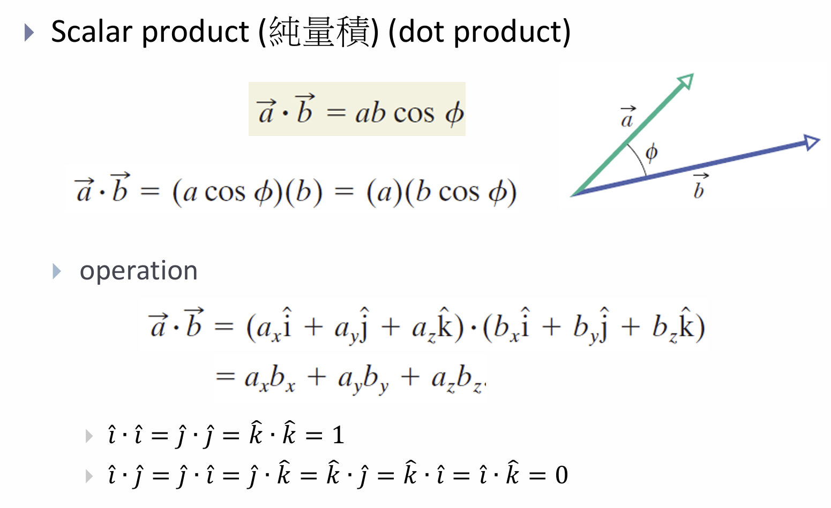

Slide 23
